Slide 1
Microcontroller Based System Design
CSE 3216
LAB 3

Slide 2
Servo Motor

Slide 3
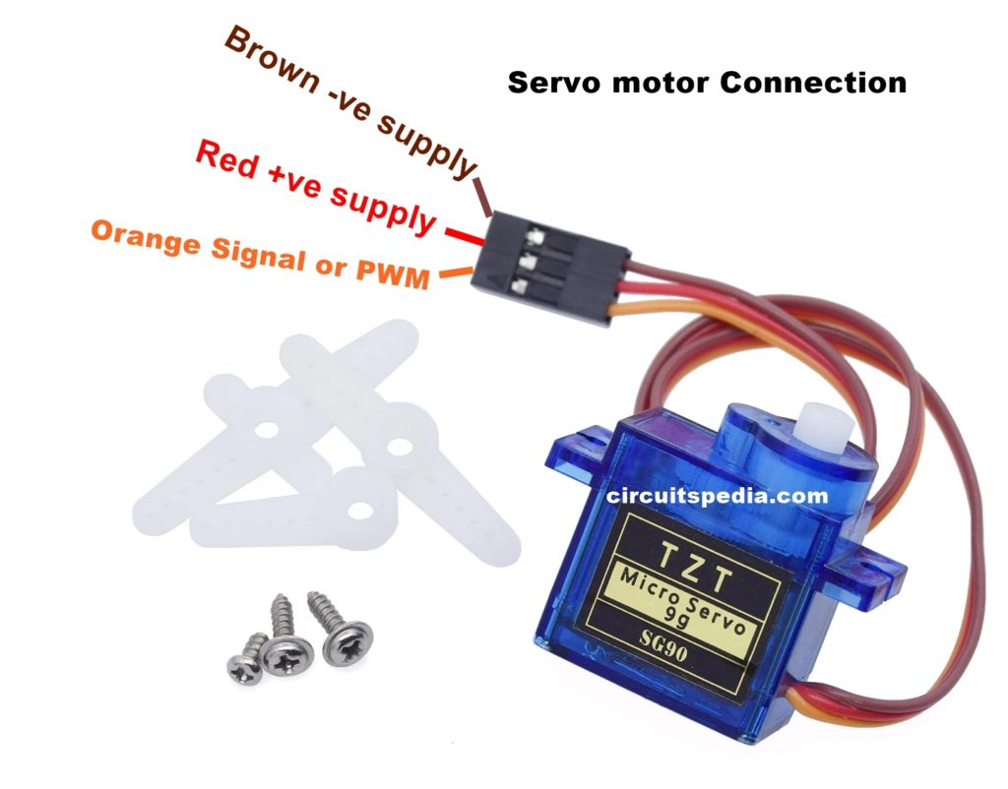
Servo Motor

Slide 4
Servo Motor(contd)
Rotation Range: 180° (-90° to +90°)
Consists of:
DC Motor,
Gear system,
Position sensor, and
Control circuit
Degree of rotation can be controlled by applying the Electrical Pulse of proper width, to its Control pin.

Slide 5
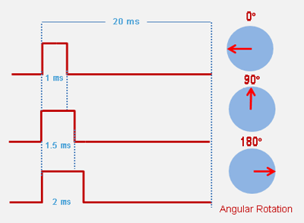
Servo Motor(contd)

Slide 6
Servo Motor(contd)
3 wires:
Red: Positive
Brown/Black: GND
Yellow/Orange: Signal

Slide 7
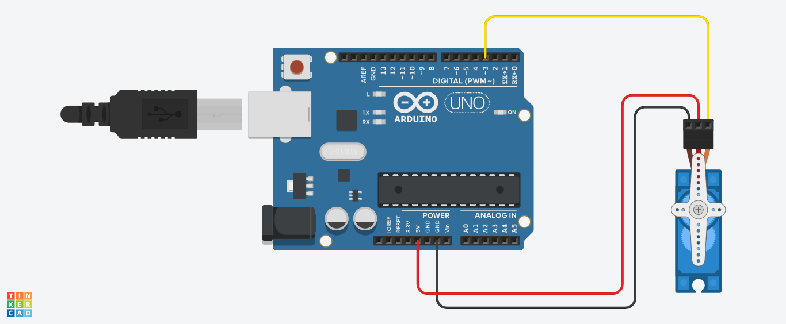
Servo Motor Arduino Connection

Slide 8
Servo Motor Arduino Code
#include <Servo.h>
Servo servo;
int angle = 10;
void setup() {
servo.attach(8);
servo.write(angle);
}
void loop()
{
for(angle = 10; angle < 180; angle++)
{
servo.write(angle);
delay(15);
}
for(angle = 180; angle > 10; angle--)
{
servo.write(angle);
delay(15);
}
}

Slide 9
Ultrasonic Sensor

Slide 10
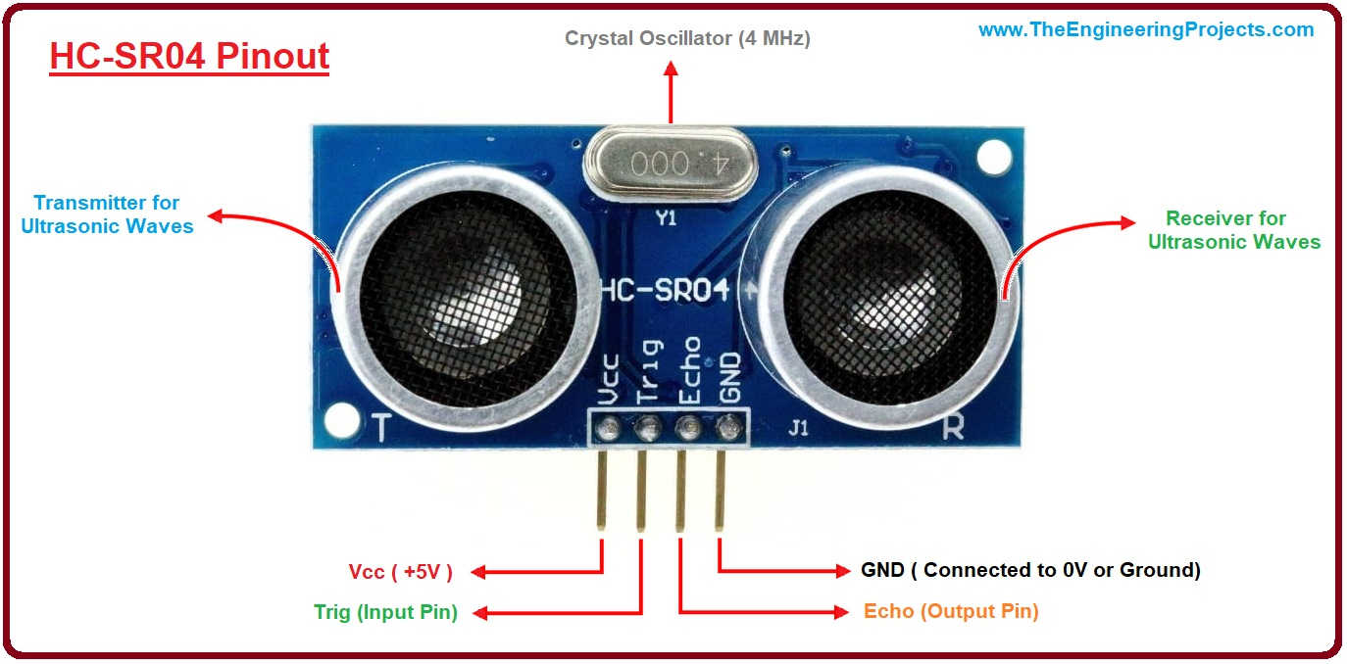
ULTRASONIC SENSOR: 4 pin

Slide 11
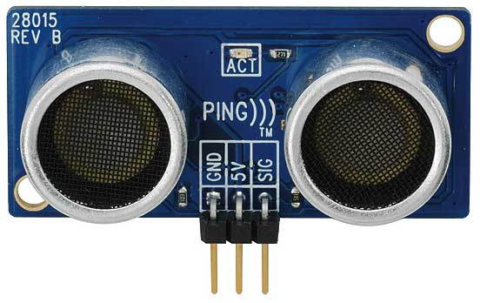
ULTRASONIC SENSOR: 3 pin

Slide 12
ULTRASONIC SENSOR (HC SR-04)

Slide 13
ULTRASONIC SENSOR: 4 pin
4 pins: positive voltage(Vcc), ground(GND), trigger pin and echo pin
Consists of: two ultrasonic transducers (one for transmission and one for reception)
Ultrasound: high-pitched sound waves with frequencies higher than the audible limit of human hearing i.e. higher than 20 KHz
Model HC SR-04 converts electrical signal into 40 KHz ultrasonic sound pulses
Detection Range: 2 cm-4 meter

Slide 14
ULTRASONIC SENSOR: 4 pin
Trig (Trigger) pin: Used to trigger the ultrasonic sound pulses.
Echo pin: Produces a pulse when the reflected signal is received. The length of the pulse is proportional to the time it took for the transmitted signal to be detected.

Slide 15
ULTRASONIC SENSOR: 3 pin
3 pins: positive voltage(Vcc), ground(GND), signal pin
Consists of: two ultrasonic transducers (one for transmission and one for reception)

Slide 16
ULTRASONIC SENSOR: 3 pin
Signal pin: Combines the functionality of trigger pin and echo pin.

Slide 17
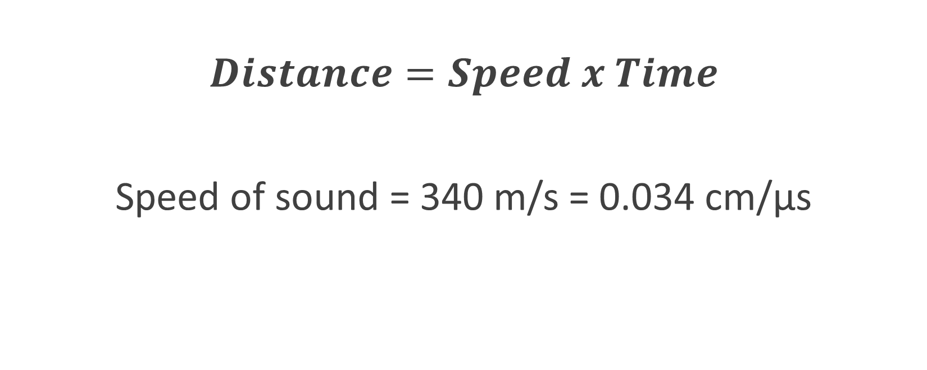
ULTRASONIC SENSOR Formula
$$Distance=Speed x Time$$
Speed of sound = 340 m/s = 0.034 cm/μs

Slide 18
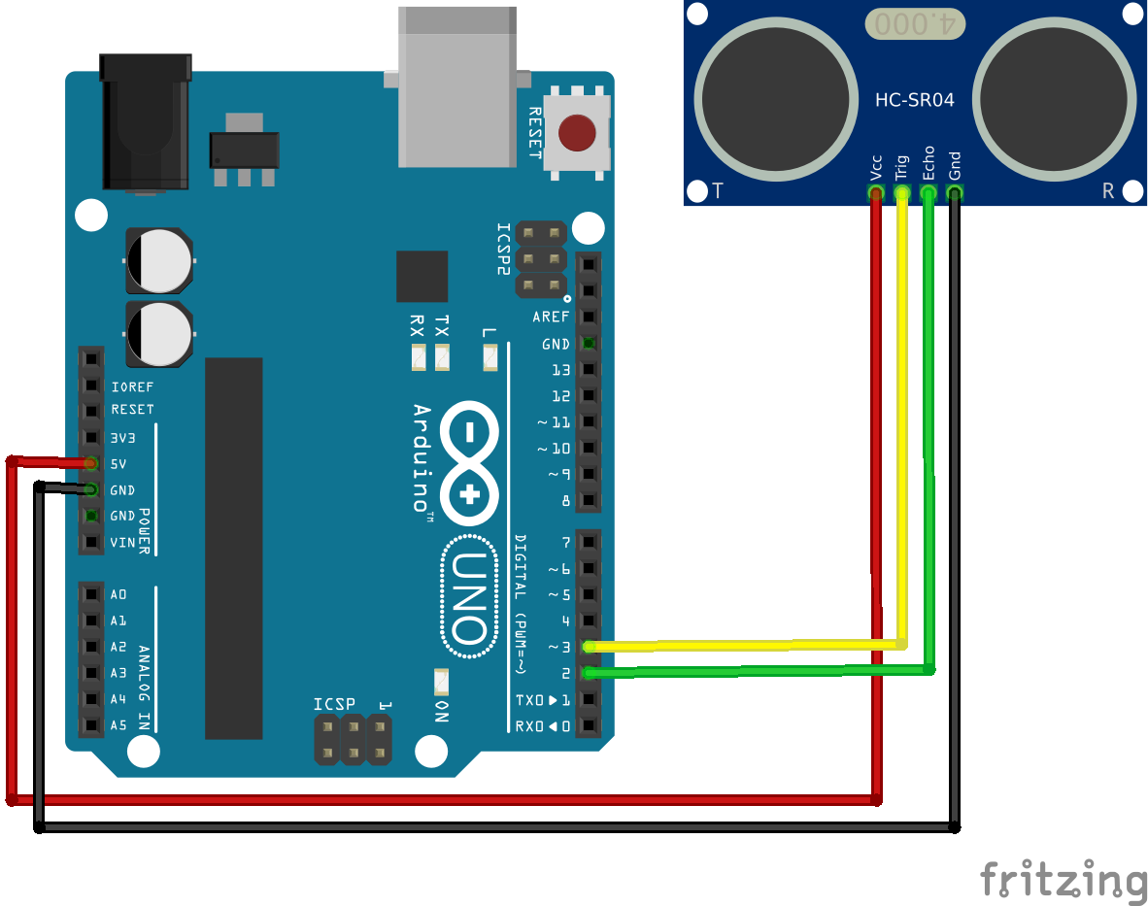
Ultrasonic Sensor Arduino Connection

Slide 19
Ultrasonic Sensor Arduino Code: 4 pin
const int trigPin = 9;
const int echoPin = 10;
long duration;
int distance;
void setup() {
pinMode(trigPin, OUTPUT);
pinMode(echoPin, INPUT);
Serial.begin(9600);
}
void loop() {
digitalWrite(trigPin, LOW); //clear trigger pin
delay(2);
digitalWrite(trigPin, HIGH);
delay(10); // Set trigPin on HIGH state for 10 micro seconds
digitalWrite(trigPin, LOW);
duration = pulseIn(echoPin, HIGH); // Reads the echoPin, returns the sound wave travel time in microseconds
distance= (duration*0.034)/2;
Serial.print("Distance(cm): ");
Serial.println(distance);
delay(1000);
}

Slide 20
Ultrasonic Sensor Arduino Code: 3 pin
const int sigPin = 9;
long duration;
int distance;
void setup() {
Serial.begin(9600);
}
void loop() {
pinMode(sigPin, OUTPUT);
digitalWrite(sigPin, LOW);
delay(2);
digitalWrite(sigPin, HIGH);
delay(10);
digitalWrite(sigPin, LOW);
pinMode(sigPin, INPUT);
duration = pulseIn(echoPin, HIGH);
distance= (duration*0.034)/2;
Serial.print("Distance(cm): ");
Serial.println(distance);
delay(1000);
}

Slide 21
THE END

